Slide 1
Welcome to SIT737
Service Oriented Architecture
Lecture 1
Dr. Alessio Bonti
Notes:
Good morning , my name is alessio bonti
Today I will talk about “from commonuties to Blockchain sharing economies”

Slide 2
Welcome To Your First SIT737 class
Get comfortable, introduce yourself to the person next to you

Slide 3

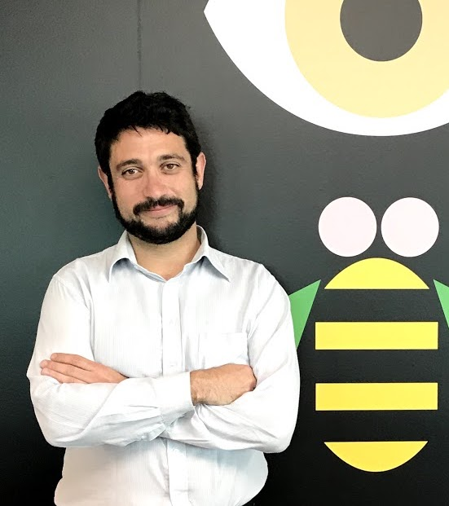
Welcome!
My name is Alessio Bonti
I was sitting in the same chair you are now sitting until 2007.
I completed my PhD at Deakin in 2012
I worked for IBM Research Australia between 2012 and 2018
Things I like
Cloud Application Design
Blockchain
Create Great User Experiences
Notes:
So This is my current research focus, both scientifically and also from an industry persespecitve

Slide 4
What will you learn?
1
SOA Core Concepts
Foundations and constituent technologies
Service orientation, virtualisation, utility computing, Web 2.0 …
SOA and Cloud computing characteristics
Elastic scalability, ubiquity, pay-as-you-go, operational vs capital costs …
Cloud computing reference model
IaaS, PaaS, SaaS, XaaS, private cloud, public cloud, hybrid cloud …
Notes:
First something about me
I spent 8 years studying at Deakin and I currently work for IBM Research
I am a research software engineer and among things I contriubte to scientific activities, patens , develop software and lead client engagements

Slide 5
What will you learn?
2
SOA Driven Development
Application development
Application design and architecture, service composition …
Architecture patterns
Stateless application, failure management, queue, …
Development operations (DevOps) enablement
Development toolchains, continuous delivery, build pipelines, …
Notes:
First something about me
I spent 8 years studying at Deakin and I currently work for IBM Research
I am a research software engineer and among things I contriubte to scientific activities, patens , develop software and lead client engagements

Slide 6
What will you learn?
3
SOA and the IT industry
Offerings and market segmentation
Infrastructure, platform, software as a service and other solutions
Cloud computing major players
Short overview of the different solutions available and markets
Uses of SOA
Practical applications in different domains
Notes:
First something about me
I spent 8 years studying at Deakin and I currently work for IBM Research
I am a research software engineer and among things I contriubte to scientific activities, patens , develop software and lead client engagements

Slide 7
At the end of the course ….
You
Will
Understand what is SOA
Be able to articulate its distinctive features
What defines SOA? …what makes it different?
Understand different SOA strategies
Which type of strategies are available? .. how do they differ?
Identify the right solution for a given business case
What specific offering solves what problem?
Notes:
First something about me
I spent 8 years studying at Deakin and I currently work for IBM Research
I am a research software engineer and among things I contriubte to scientific activities, patens , develop software and lead client engagements

Slide 8
At the end of the course ….
You
Will
Develop SOA based applications
Define the architecture of cloud applications
Define an application in terms of components and behaviour.
Use service composition to build applications
Express applications and its features through service composition.
Understand and apply Service architecture patterns
Know the key patterns, and which problem they address.
Notes:
First something about me
I spent 8 years studying at Deakin and I currently work for IBM Research
I am a research software engineer and among things I contriubte to scientific activities, patens , develop software and lead client engagements

Slide 9
How is this course structured?
Lectures
Introduction and discussion of the course topics
The theory and the key concepts are introduced and discussed with the students through questions and answers sessions.
Labs
Hands-on the technology and practice sessions
A closer and more detailed look to the technology introduced during the lectures is given and exercises and tutorial will be the primary mean to get practical skills.
Notes:
Want to use block chain
To redefine trust
In order to empower people
To reinvent economies

Slide 10
How will you be assessed?
Mark
Breakdown
20%
Assignment 1 - Team based report
20%
Assignment 2 - Team based, design and implement cloud application
60%
Final exam - 2 hours, closed book, questions on topics discussed during the course
Notes:
Want to use block chain
To redefine trust
In order to empower people
To reinvent economies

Slide 11
Timetable and Attendance
Attendance is compulsory
It will be recorded
Type/Stream |  | Day | Start/End | Campus | Location | Teaching weeks
Class 1 | 01 | Fri | 13:00-13:50 | Burwood | LT 7 (Y2.04) | 01, 02, 03, 04, 05, 06, 07, 08, 09, 10, 11
Practical 1 | 01 | Tue | 11:00-12:50 | Burwood | T1.06 | 01, 02, 03, 04, 05, 06, 07, 08, 09, 10, 11
Practical 1 | 03 | Thu | 12:00-13:50 | Burwood | T1.01 | 01, 02, 03, 04, 05, 06, 07, 08, 09, 10, 11
Practical 1 | 04 | Fri | 11:00-12:50 | Burwood | T1.04 | 01, 02, 03, 04, 05, 06, 07, 08, 09, 10, 11
Practical 1 | 02 | Fri | 14:00-15:50 | Burwood | T1.06 | 01, 02, 03, 04, 05, 06, 07, 08, 09, 10, 11
Practical 1 | 05 | Fri | 16:00-17:50 | Burwood | T1.05 | 01, 02, 03, 04, 05, 06, 07, 08, 09, 10, 11
Notes:
Want to use block chain
To redefine trust
In order to empower people
To reinvent economies

Slide 12
Practical Work
Classes will be posted on Cloud Deakin
Announcements
Discussion forums
Weekly laboratory tasks
Objective will be given for each session
Only some will have solutions
Be proactive, class does not end when the bell rings, keep practicising and exploring more at home
Notes:
Want to use block chain
To redefine trust
In order to empower people
To reinvent economies

Slide 13
Plagiarism
No!
Please don’t do it……
Students should be aware of the seriousness of cheating and the penalties associated with it.
Cheating includes copying from another student's work or allowing another student to copy one's own work, allowing someone else to prepare your assignment in part or as a whole, consultation with any unauthorised person during an examination or test, and the use of unauthorised aids.
All material submitted for marking must be the student’s original work.
Notes:
First something about me
I spent 8 years studying at Deakin and I currently work for IBM Research
I am a research software engineer and among things I contriubte to scientific activities, patens , develop software and lead client engagements

Slide 14
Plagiarism
Must Read!
Students who obtain too much assistance without learning the material ultimately hurt themselves. These students usually do poorly in tests because they have not mastered the lecture topics or practical exercises. Although students are free to discuss ideas used to complete assignments, work that is handed in must be written independently by the student concerned.
You MUST read and fully understand the implications of the Faculty’s Notice on Plagiarism on CloudDeakin prior to submitting your assignments.
Notes:
First something about me
I spent 8 years studying at Deakin and I currently work for IBM Research
I am a research software engineer and among things I contriubte to scientific activities, patens , develop software and lead client engagements

Slide 15
Let’s start – what is a web service?
Let’s do the first thing an experienced developer would do …

Slide 16
Google “What is a Web Service?”
“A web service is a service offered by an electronic device to another electronic device, communicating with each other via the World Wide Web”
Google

Slide 17
Engineers are 1 || 0
Technology is not an opinion.
People have opinions and are part of the technology.
People are users, users need solutions, solutions are obtained through technology

Slide 18
As a user I want to ……
Give life to my Tjbot!
I want him to speak
I want him to hear
I want him to see
I am not Frankenstein!

Slide 19
Bring Tee to life!
By the end of this trimester, Tee should be able to satisfy our simplest tasks.
We will use web services to bring him to life!
Welcome again and enjoy your time here at Deakin, remember, learning does not stop outside these doors.

Slide 20
Any Questions?
Notes:
Want to use block chain
To redefine trust
In order to empower people
To reinvent economies

